Slide 1
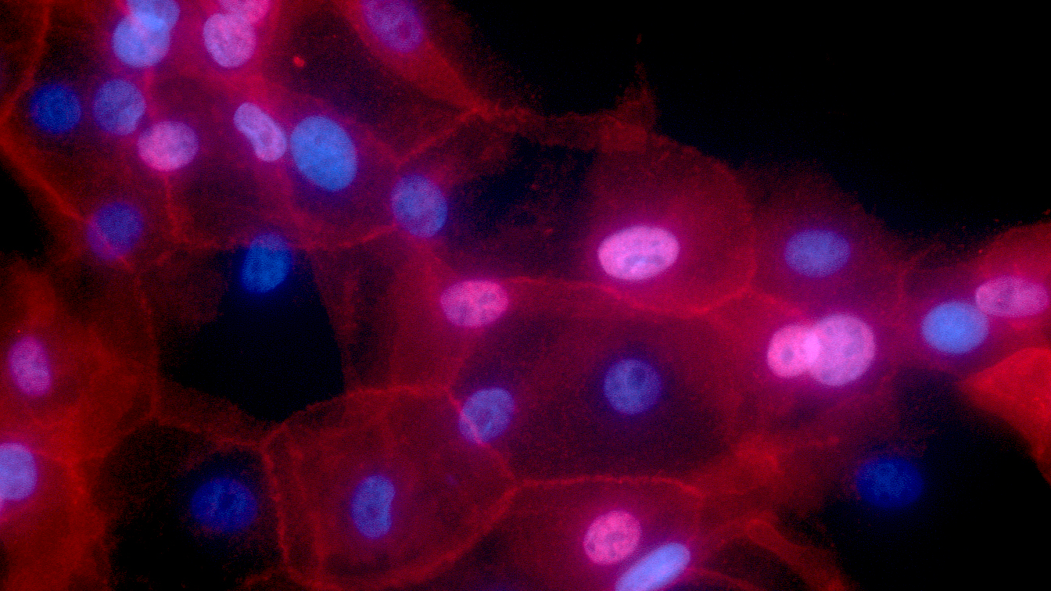
The genetics of mammary carcinomas in dogs
Sophie Agger, PhD student
Supervisors:
Associate professor Maja Arendt, DVM, PhD, DipECVIM-CA(onc)
Professor Kerstin Lindblad-Toh, PhD Professor Annemarie T. Kristensen, DVM, PhD, DACVIM-SA, DipECVIM-CA, DipECVIM-CA(onc)
Credit: Ewa Krawczyk, National Cancer Institute \ Georgetown Lombardi Comprehensive Cancer Center, National Institutes of Health
Notes:
The image shows cell culture of human breast cancer conditionally reprogrammed cells. Fluorescence red color represents MHC-I, and nuclei are shown in blue.

Slide 2
Why investigate mammary cancer in dogs?
For dogs
High incidence
Diagnostics are insensitive and invasive
Treatment options are limited
For humans
Improving a translational model
 | Dogs | Rodents
Spontaneous occurrence | Yes | No
Similar disease course | Yes | Maybe
Progression speed | + | ++
Genetic variation | - | —
Laboratory animals | No | Yes
Price | Expensive | Cheap
Environment | Same | Different
Information on genotype | Bad | Good
Diagnostic scheme | Different | Same
Notes:
Perhaps some of you remember the hallmarks of cancer, in order for a cell to become cancerous, these traits need to be aqcuired. I won’t go through all of them, but they all lead to loss of normal cellular regulation.
Many different mutations can lead to the auisition of these traits and the mutational patterns are useful for predicting prognosis and effectiveness of treatment.
A classic example of a tumor-driver mutation is mutations in the tumor supressor TP53. This gene encodes the protein p53 that is very important for cell maintenance by reacting to DNA damage.
P53 reacts to DNA damage in several ways. It activates DNA repair mechanisms and can stop the cell cycle until DNA damage is fixed. Thus, a loss of function in this gene can lead to genomic instability and an increased risk of further mutations.
So. How does mutations in general relate to cancer?

Slide 3
Why investigate mammary cancer in dogs?
For dogs
High incidence
Diagnostics are insensitive and invasive
Treatment options are limited
For humans
Improving a translational model
 | Dogs | Rodents
Spontaneous occurrence | Yes | No
Similar disease course | Yes | Maybe
Progression speed | + | ++
Genetic variation | - | —
Laboratory animals | No | Yes
Price | Expensive | Cheap
Environment | Same | Different
Information on genotype | Bad | Good
Diagnostic scheme | Different | Same
Notes:
Perhaps some of you remember the hallmarks of cancer, in order for a cell to become cancerous, these traits need to be aqcuired. I won’t go through all of them, but they all lead to loss of normal cellular regulation.
Many different mutations can lead to the auisition of these traits and the mutational patterns are useful for predicting prognosis and effectiveness of treatment.
A classic example of a tumor-driver mutation is mutations in the tumor supressor TP53. This gene encodes the protein p53 that is very important for cell maintenance by reacting to DNA damage.
P53 reacts to DNA damage in several ways. It activates DNA repair mechanisms and can stop the cell cycle until DNA damage is fixed. Thus, a loss of function in this gene can lead to genomic instability and an increased risk of further mutations.
So. How does mutations in general relate to cancer?

Slide 4
Aims
Description of the mutational landscape in canine mammary carcinomas?
Correlate with phenotype
Compare with breast cancer
Is tumor DNA present in blood in dogs with mammary carcinoma?
Notes:
Er der cfDNA mens tumor er present
Kan det genfindes ved senere kontroller
Bruges til at tracke sygdom, findes det før synlige metastaser (snyd relativt til mennesker da dårligere modaliteter).
Evt. undersøge sammenhæng mellem mængde og sygdomsbyrde (større tumor, mere ctDNA?)
(Is there a correlation between ctDNA levels and disease burden)

Slide 5
Aims
Description of the mutational landscape in canine mammary carcinomas?
Correlate with phenotype
Compare with breast cancer
Is tumor DNA present in blood in dogs with mammary carcinoma?
Notes:
Er der cfDNA mens tumor er present
Kan det genfindes ved senere kontroller
Bruges til at tracke sygdom, findes det før synlige metastaser (snyd relativt til mennesker da dårligere modaliteter).
Evt. undersøge sammenhæng mellem mængde og sygdomsbyrde (større tumor, mere ctDNA?)
(Is there a correlation between ctDNA levels and disease burden)

Slide 6
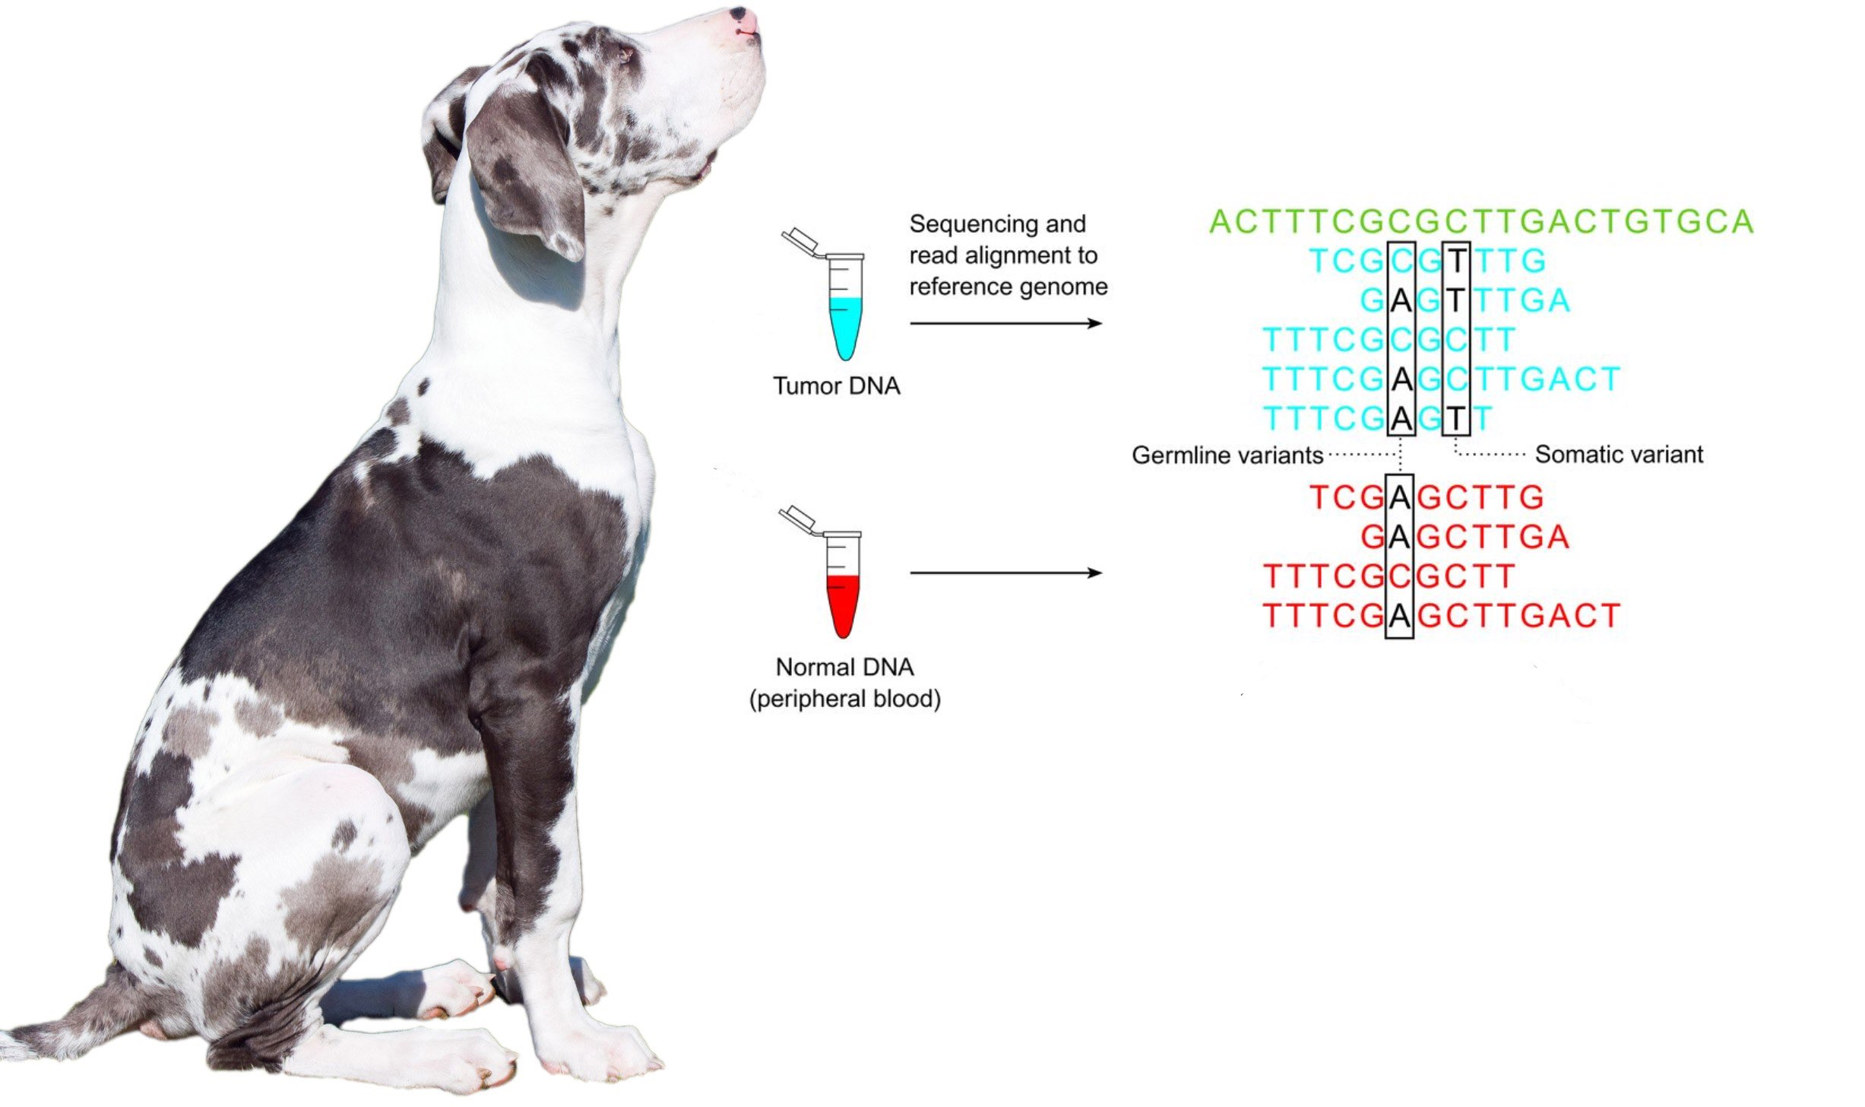
Mutational landscape
Tumor mutations
Genetic variation
Mutations in tumor – individual variation =
Somatic mutations
Edited from publicdomainpictures and http://clinchem.aaccjnls.org/content/59/1/127
Notes:
And how are we doing this?
The short version is that to find which mutations are present in the tumor, we look at all the variation found in the tumor and subtract the variation found in the normal cells.
These mutations are the mutations found only in the tumor and they (or some of them) are the underlying reason for development of cancer.

Slide 7
Aims
Description of the mutational landscape in canine mammary carcinomas?
Correlate with phenotype
Compare with breast cancer
Is tumor DNA present in blood in dogs with mammary carcinoma?
Notes:
Er der cfDNA mens tumor er present
Kan det genfindes ved senere kontroller
Bruges til at tracke sygdom, findes det før synlige metastaser (snyd relativt til mennesker da dårligere modaliteter).
Evt. undersøge sammenhæng mellem mængde og sygdomsbyrde (større tumor, mere ctDNA?)
(Is there a correlation between ctDNA levels and disease burden)

Slide 8
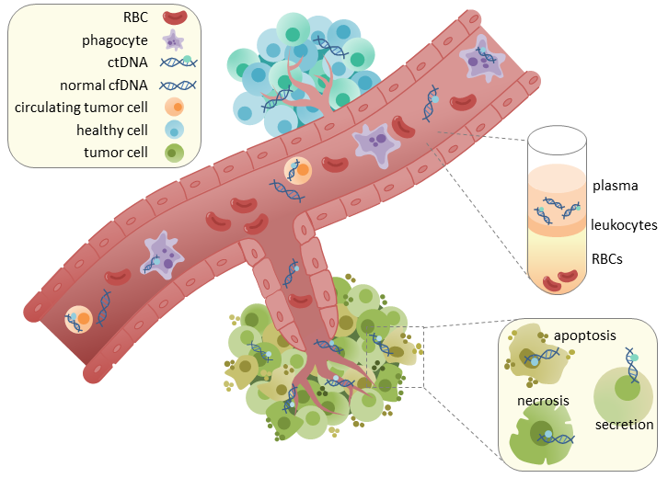
Cell-free DNA as a biomarker
Are the mutations in the tumor present in the blood?
Tumor
Notes:
Every time a cell dies some amount of DNA will be released, this amount is increased in tumors, due to increased rate of necrosis, hypoxia, unstable cells etc.
This tumor DNA will contain the variations found in the cancer cells and due to a very short half-life (some say less than 2 hours) it can be used as reliable marker for presence of tumor cells. So the idea is that you remove the tumor and mutations specific to the tumor is present in the cfDNA you know that there’s tumor cells left behind and adjuvant treatment is needed. Of course a certain tumor burden is needed before it’s detectable, but it should be more sensitive than the current modalities such as CT. It can also be used as a long-term follow up modality. Instead of having to do mammograms, CT’s and fine-needle aspirates, you can monitor the peripheral blood for tumor specific mutations and react earlier to any sign of relapse (due to the modality being more sensitive) especially if the metastasis is diffuse or internal.
Nogen siger 50 mio maligne celler er nok til at give målbar ctDNA

Slide 9
Data collection
2 m 4 m 6 m 8 m 10 m 12 m
18 m
Biopsy of tumor
Blood sample
Clinical examination
Histopathology
Tumor DNA
Restaging is performed
when clinically relevant
Blood sample
Normal DNA
Cell-free DNA
Cell-free DNA
Notes:
Right now, it’s hard to follow disease progression of cancers due to the relative low sensitivity and invasiveness of imaging modalities. We’re looking into following disease progression using liquid biopsies. The idea is to find tumor-specific mutations in the tumor and then looking for these in the liquid biopsy.
The focus is to 1) is it present 2) is it useful for tracking mammary tumor progression and tumor evolution.
Prove that ctDNA is present in dogs with aggressive mammary tumors
Follow the levels of ctDNA over time
Is ctDNA present before metastasis / regrowth is observed by conventional means?
Follow evolution of mutations over time – f.eks. For metastasis, thecells needto be able to: Go through basal membrane and invade new tissues. Tthese muttations are not necessarily present in the primary tumor.
Is the mutational pattern the same at diagnosis and at relapse?

Slide 10
ctDNA – Limitations
ctDNA undetectable
Absolute amount
Relative to blood sample-size
Methodology
Subclones – especially if targeted methods
At control
Patient is cured
Patients not monitored long enough

Slide 11
ctDNA – Limitations
ctDNA undetectable
Absolute amount
Relative to blood sample-size
Methodology
Subclones – especially if targeted methods
At control
Patient is cured
Patients not monitored long enough

Slide 12
ctDNA study - Sequencing
Different methods are available, due to sequencing depth, it is hard to know how it translates to our case
Estimated cfDNA input: 1-100ng
WGS
”Easy”
Low sensitivity
Captures all changes
Tumor evolution
Capture
Labor intensive
High sensitivity
Only looks at subset
Relies on capture-kits
Must be well-functioning
Must choose correct targets

Slide 13
RNAseq - Aim
Investigate expression patterns in canine mammary carcinomas
Hormonal receptors
Expression patterns
Compare different tumor types
Only carcinomas – maybe subtypes
Compare with somatic variation found in T/N
Pathway analysis
Notes:
Subclones – mismatch between sample from tumor and ctDNA
RNA seq – gene expression in WBC isn’t really comparable to mammary tissue and even if I had ”normal” mammary tissue, it probably wouldn’t be normal anyway, also, hormonal influence. Perhaps making a panel from young bitches, before hormones have affected the tissue too much.

Slide 14
RNAseq - Limitations
No normal sample from the same tissue for comparison
Hormonal influence at sample time
Solutions
Normal mammary tissue
Same dog -> likely no normal mammary tissue
Microdissection?
Other dogs -> panel of normal expression
Ethics of sampling healthy dogs (biopsy/FNA)
Young dogs probably needed due to hormonal influence over time
Notes:
Subclones – mismatch between sample from tumor and ctDNA
RNA seq – gene expression in WBC isn’t really comparable to mammary tissue and even if I had ”normal” mammary tissue, it probably wouldn’t be normal anyway, also, hormonal influence. Perhaps making a panel from young bitches, before hormones have affected the tissue too much.
Preferably before 3. heat, but should not be puppy.

Slide 15
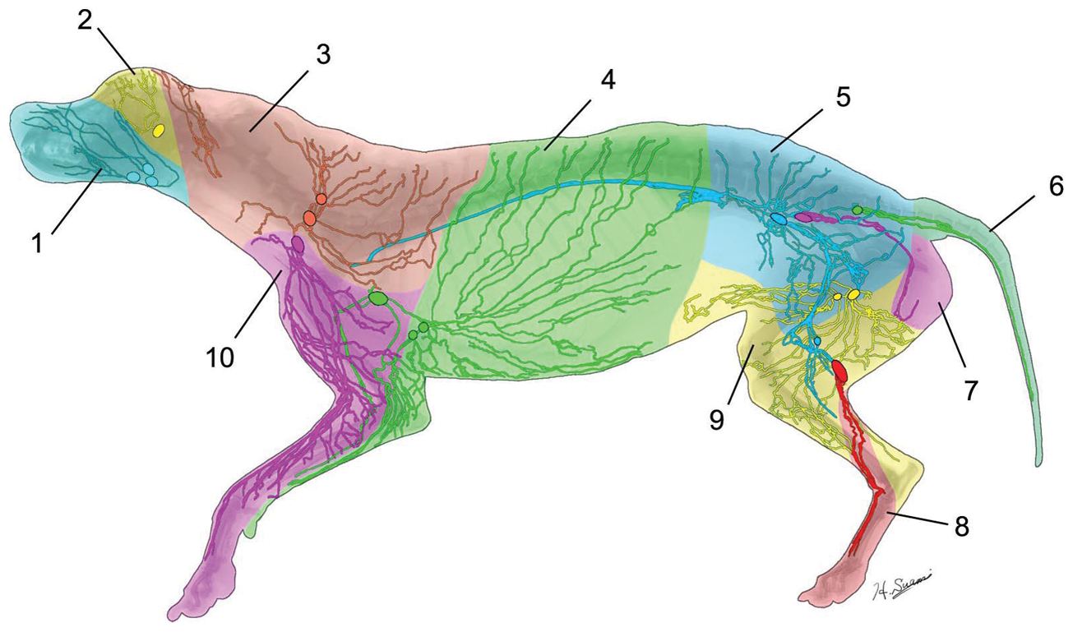
Clinical challenges Staging
Notes:
Staging
Why does it matter?
When treating cancer the treament dose is important – that means how much to remove and whether or not to follow up with other therapy such as chemotherapy.
In order to decide on treatment, you need to know where the cancer is. If it has spread to lymph nodes, it will not be sufficient to remove the tumor. However this is complicated by several factors. One is that the metastasis need to be present where we look and have a certain size.
For lymph nodes we have 2 main issues. The unpredictable drainage pattern – and size/placement of lymph nodes and the number of metastatic cells. Even if you find the correct lymph node, you might still miss the cancer cells.
For distant metastasis the issue is mostly an issue of size of metastasis, a few cells won’t show up on a CT.
Treatment dose
Surgical dose
Adjuvant therapy

Slide 16
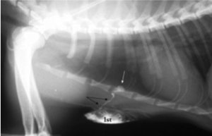
Clinical challenges Staging
Notes:
Staging
Why does it matter?
When treating cancer the treament dose is important – that means how much to remove and whether or not to follow up with other therapy such as chemotherapy.
In order to decide on treatment, you need to know where the cancer is. If it has spread to lymph nodes, it will not be sufficient to remove the tumor. However this is complicated by several factors. One is that the metastasis need to be present where we look and have a certain size.
For lymph nodes we have 2 main issues. The unpredictable drainage pattern – and size/placement of lymph nodes and the number of metastatic cells. Even if you find the correct lymph node, you might still miss the cancer cells.
For distant metastasis the issue is mostly an issue of size of metastasis, a few cells won’t show up on a CT.

Slide 17
Research questions - Tumor/normal study
Improving the molecular understanding of canine mammary carcinomas
Look for somatic mutations in canine mammary carcinomas
Known oncogenes
Known tumor-suppressor genes
Regulatory areas
Correlate to clinical phenotype
Compare with mutations in human cancers
Improving dogs as a model for human cancer

Slide 18
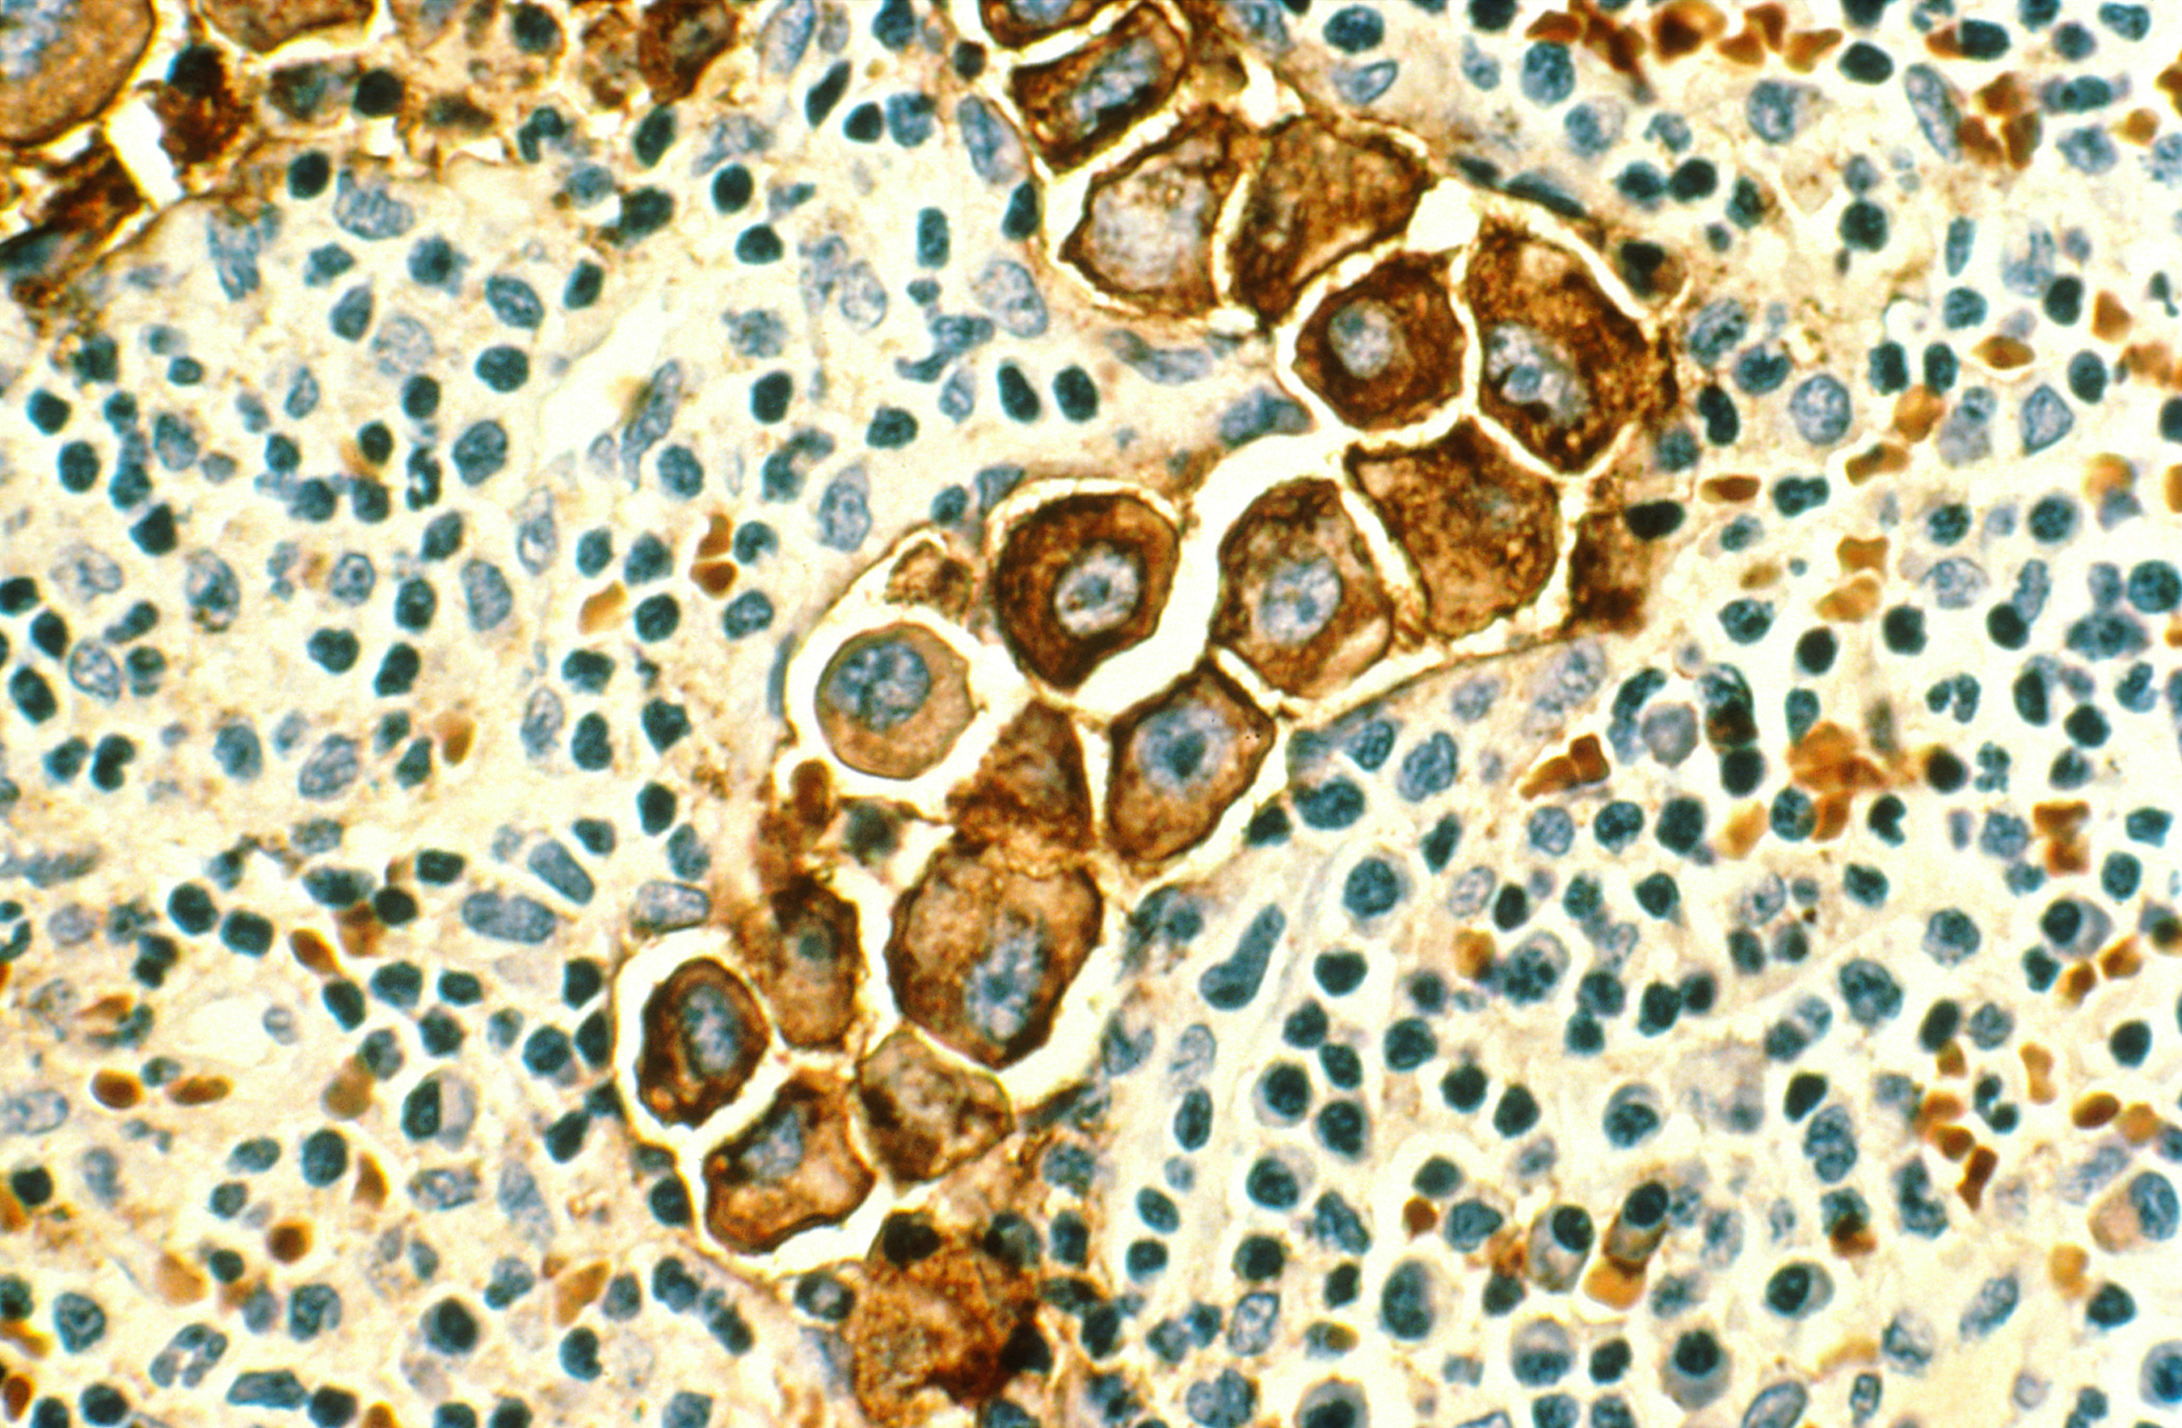
Clinical challenges Staging
Lymph node metastasis
Notes:
Staging
Why does it matter?
When treating cancer the treament dose is important – that means how much to remove and whether or not to follow up with other therapy such as chemotherapy.
In order to decide on treatment, you need to know where the cancer is. If it has spread to lymph nodes, it will not be sufficient to remove the tumor. However this is complicated by several factors. One is that the metastasis need to be present where we look and have a certain size.
For lymph nodes we have 2 main issues. The unpredictable drainage pattern – and size/placement of lymph nodes and the number of metastatic cells. Even if you find the correct lymph node, you might still miss the cancer cells.
For distant metastasis the issue is mostly an issue of size of metastasis, a few cells won’t show up on a CT.
Treatment dose
Surgical dose
Adjuvant therapy

Slide 19

Background
Improve understanding of cancer
Mammary tumors
Notes:
So, the first the project looks at the somatic mutations found in osteosarcomas, lymphomas, and mammary tumors.
Both osteosarcoma and lymphoma has a bad prognosis in general, there are a lot of mammary tumors and breast cancer and thus, all 3 tumor types have a very high impact on both dogs and humans.
Right now it’s hard to compare data between dogs andhumans, as the canine classification is primarily based on histopathology, while the human is mostly molecular in nature
While the project focuses on investigating the canine forms, the information can also help human cancer patients by enhancing the dog as a model for human disease but also by gaining more knowledge in general about the subtypes present in both species.
Describing the mutational landscape in order to:
Improve subtyping
Improve understanding of the cancers
Improve the dog as a model for human disease
Correlate mutational patterns with clinical characteristics
Better prognostication and treatment options

Slide 20
ctDNA study - Aim
Proof-of-concept
Is cfDNA present in dogs
Is the amount stable over time
Is ctDNA is present in dogs with mammary tumors
Benign tumors
Carcinomas
Monitoring
Is ctDNA detectable before/at relapse in carcinomas
Notes:
I don’t necessarily expect the cfDNA level to be stable comparing T0 with the rest, as there’s the chance that the tumor elevate it.

Slide 21
Study design – Sample Processing
Normal sample
WGS sequencing at ~20X
WGS sequencing at ~60 X
Low coverage WGS screening for tumor mutations
Normal T/N study
Tumor sample
Cell-free plasma sample
High coverage WGS
(Confirm with ddPCR)
If present

Slide 22
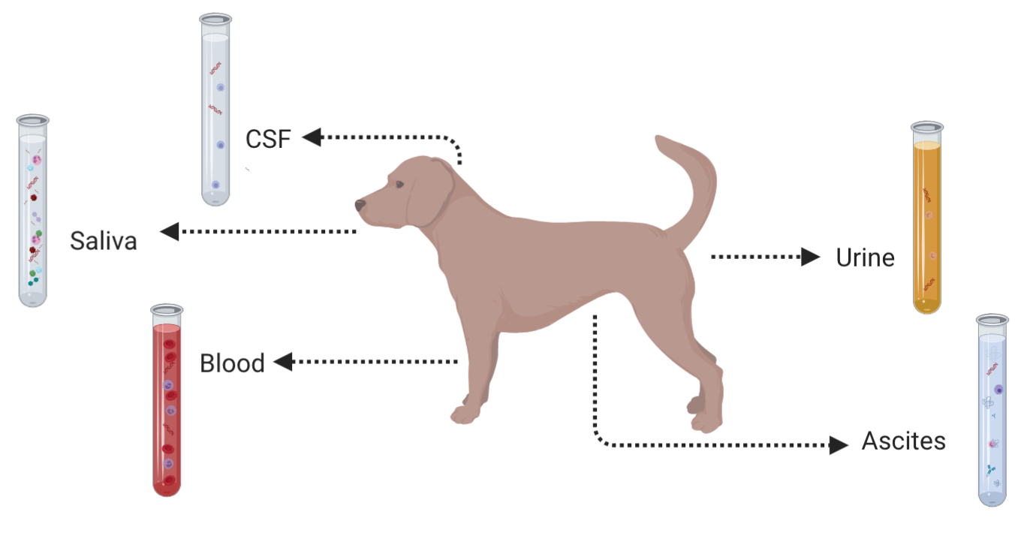

Liquid biopsy

